Slide 1
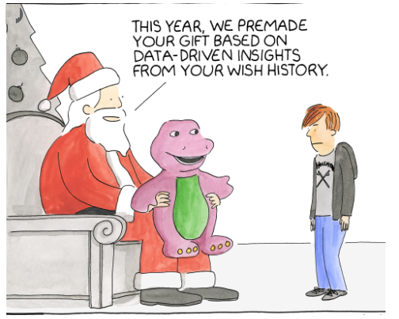
PREDICTIVE MARKETING ANALYTICS

Slide 2
Jovita Jasmine D Souza
Industry certification on Data Science and Artificial Intelligence
-Institute of Data
Bachelor of Engineering- Information Science
-St Joseph Engineering College
8 years of experience in software development and data analysis

Slide 3
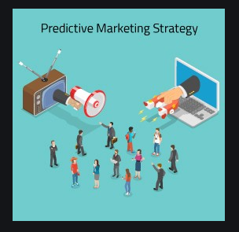
What promotional offer to give to a particular customer in a given time ?
When to give a promotional offer to a particular customer and for what value?

Slide 4
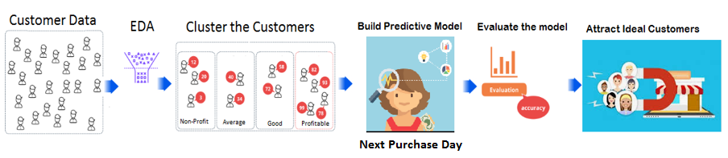
Steps :

Slide 5
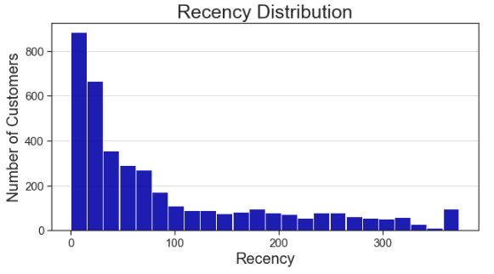
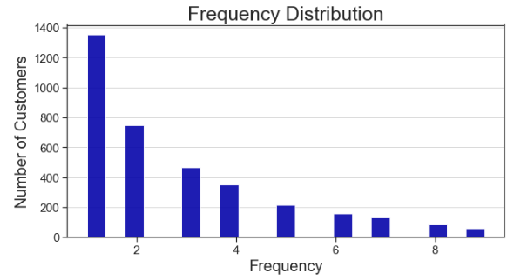
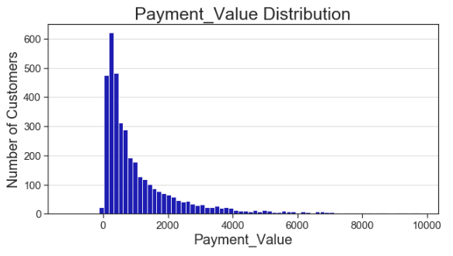
Exploratory Data Analysis

Slide 6
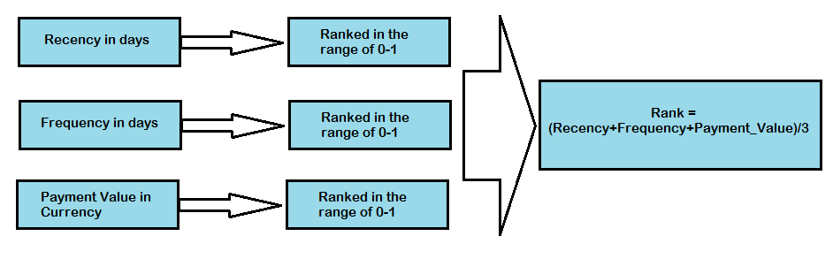
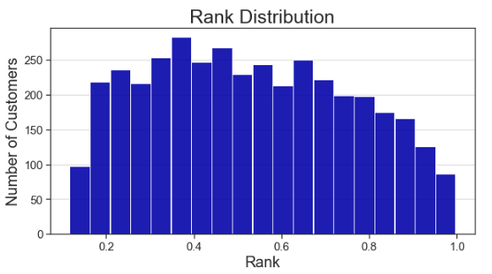
Exploratory Data Analysis

Slide 7
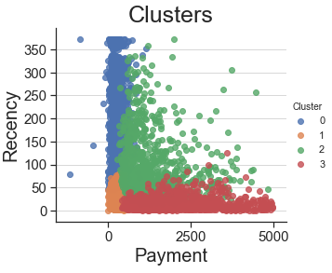
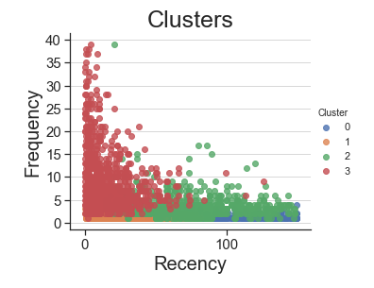
Clustering the customers

Slide 8
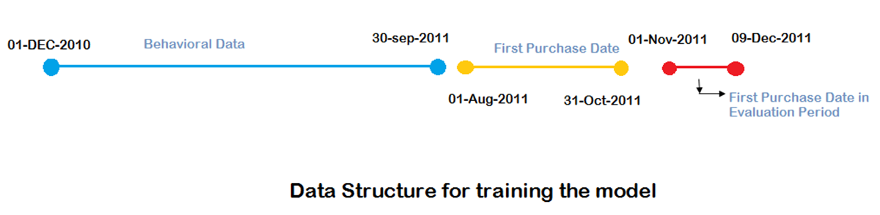
Building Predictive Modelling

Slide 9
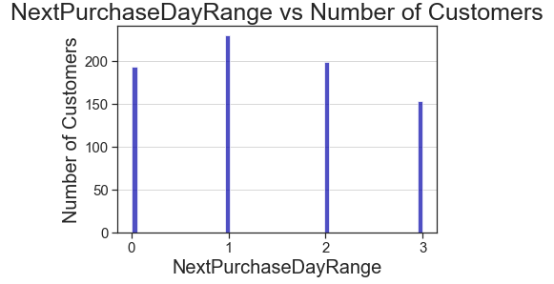
Building Predictive Modelling
Next Purchase Day | Next Purchase Day Range
0-30 | 0
31-70 | 1
71-150 | 2
151-999 | 3

Slide 10
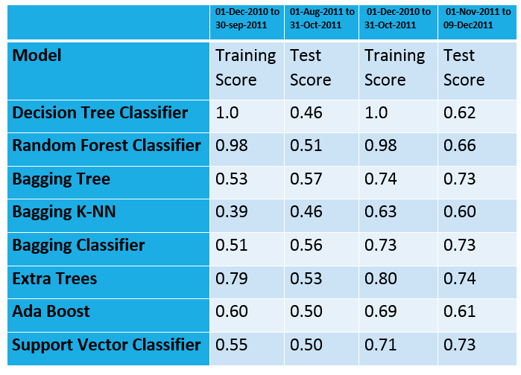
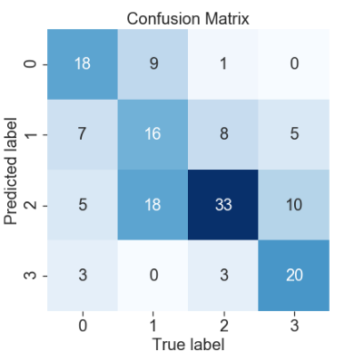
Evaluate the Model

Slide 11
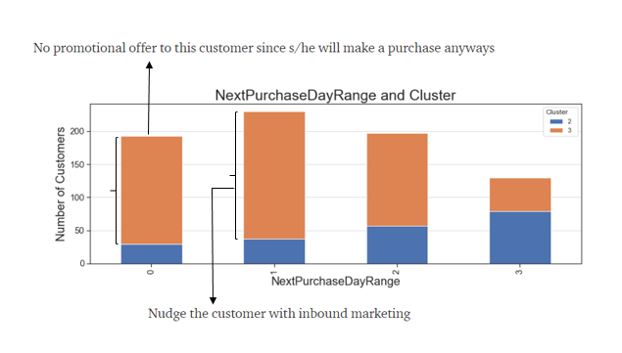
Attract Ideal Customers

Slide 12
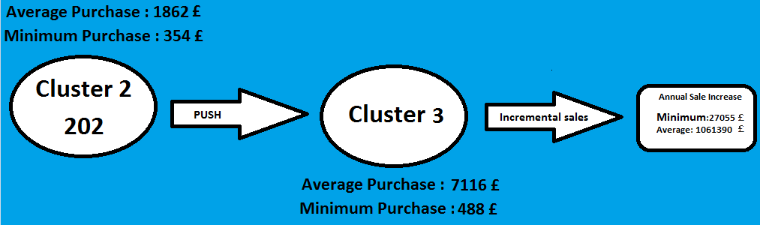
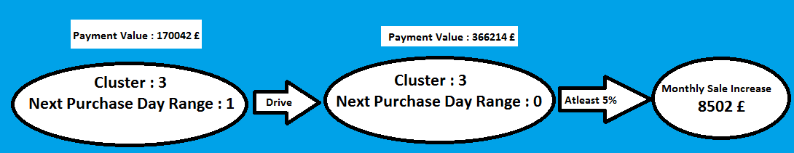
Potential Sale Increase

Slide 13
References:
http://archive.ics.uci.edu/ml/datasets/Online+Retail
https://towardsdatascience.com/data-driven-growth-with-python-part-3-customer-lifetime-value-prediction-6017802f2e0f
https://support.treasuredata.com/hc/en-us/articles/360001458407-Predicting-Customer-Behavior
https://www.wsj.com/articles/predictive-analytics-give-a-boost-to-diageos-cost-savings-efforts-11556208946

Slide 14
Thank you

